Slide 1
SHELLSHOCK ATTACK

Slide 2
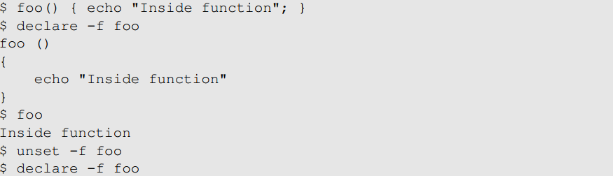
Background: Shell Functions
Shell program is a command-line interpreter in operating systems
Provides an interface between the user and operating system
Different types of shell : sh, bash, csh, zsh, windows powershell etc
Bash shell is one of the most popular shell programs in the Linux OS
The shellshock vulnerability are related to shell functions.
Notes:
Declare function – to print shell function
Unset- to remove the shell function

Slide 3
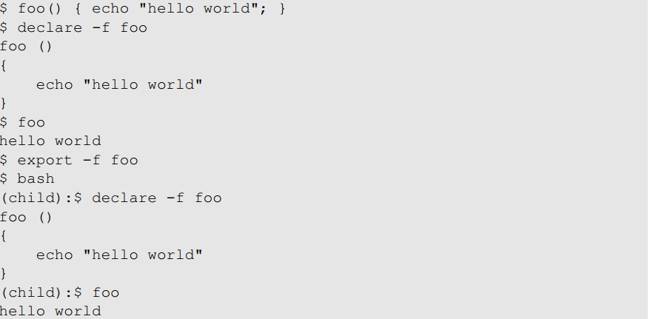
Passing Shell Function to Child Process
Approach 1: Define a function in the parent shell, export it, and then the child process will have it. Here is an example:
Notes:
Export command is used with a special flag to export the shell function for child processes
This means that when the parent shell process forks a child process and runs a shell command in the child process, the function definition will be passed down to the child process

Slide 4
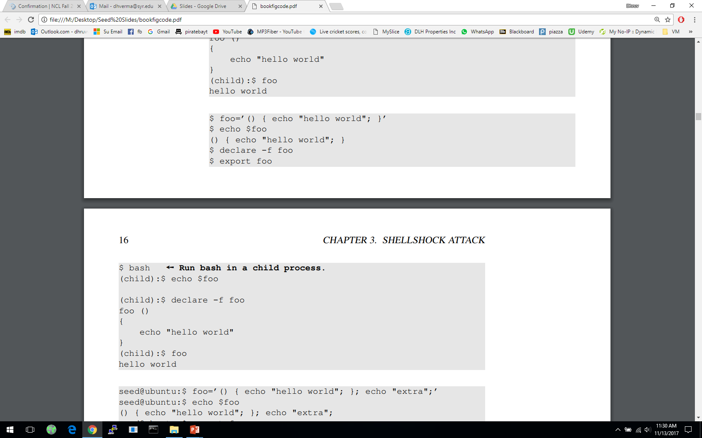
Passing Shell Function to Child Process
Approach 2: Define an environment variable. It will become a function definition in the child bash process.
Notes:
Foo starts with a pair of parenthesis, followed by a sequence of commands between two curly brackets
For the current process, there is nothing special about the parenthesis and the curly brackets.
This is why when we use declare –f foo, nothing shows up. This Is because foo is not considered a function.
When we export this variable and run a child bash, foo becomes a shell function
NOTE:
The space between () { in the declaration of foo is important
When a shell variable is marked by export command, it will be passed down as an environment variable
If the program executed in the child process is a bash shell program, it will convert the environment variable into shell variable

Slide 5
Passing Shell Function to Child Process
Both approaches are similar. They both use environment variables.
Procedure:
In the first method, When the parent shell creates a new process, it passes each exported function definition as an environment variable.
If the child process runs bash, the bash program will turn the environment variable back to a function definition, just like what is defined in the second method.
The second method does not require the parent process to be a shell process.
Any process that needs to pass a function definition to the child bash process can simply use environment variables.

Slide 6
Shellshock Vulnerability
Vulnerability named Shellshock or bashdoor was publicly release on September 24, 2014. This vulnerability was assigned CVE-2014-6271
This vulnerability exploited a mistake mad by bash when it converts environment variables to function definition
The bug found has existed in the GNU bash source code since August 5, 1989
After the identification of this bug, several other bugs were found in the widely used bash shell
Shellshock refers to the family of the security bugs found in bash

Slide 7
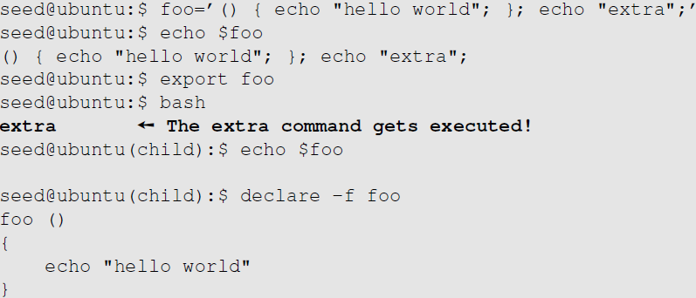
Shellshock Vulnerability
Parent process can pass a function definition to a child shell process via an environment variable
Due to a bug in the parsing logic, bash executes some of the command contained in the variable
Extra command
Notes:
We define a shell variable foo and attach an addition command after the losing bracket
When a child process is created, the child shell will parse the environment variable
During the parsing, due the bug, bash will execute the command after the curly bracket

Slide 8
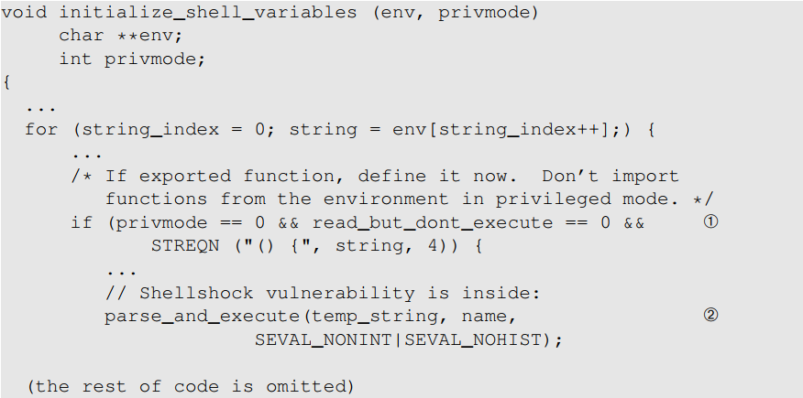
Mistake in the Bash Source Code
The shellshock bug starts in the variables.c file in the bash source code
The code snippet relevant to the mistake:

Slide 9
Mistake in the Bash Source Code
In this code, at Line ①, bash checks if there is an exported function by checking whether the value of an environment variable starts with “() {” or not. Once found, bash replaces the “=“ with a space.
Bash then calls the function parse_and_execute() ( Line②) to parse the function definition. Unfortunately, this function can parse other shell commands, not just function definition
If the string is a function definition, the function will only parse it and not execute it
If the string contains a shell command, the function will execute it.

Slide 10
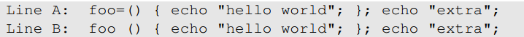
Mistake in the Bash Source Code
For Line A, bash identifies it as a function because of the leading “() {“ and converts it to Line B
We see that the string now becomes two commands.
Now, parse_and_execute() will execute both commands
Consequences:
Attackers can get process to run their commands
If the target process is a server process or runs with a privilege, security breaches can occur

Slide 11
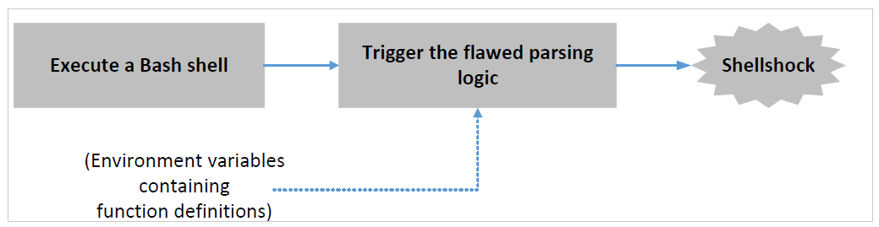
Exploiting the Shellshock Vulnerability
Two conditions are needed to exploit the vulnerability:
The target process should run bash
The target process should get untrusted user inputs via environment variables

Slide 12
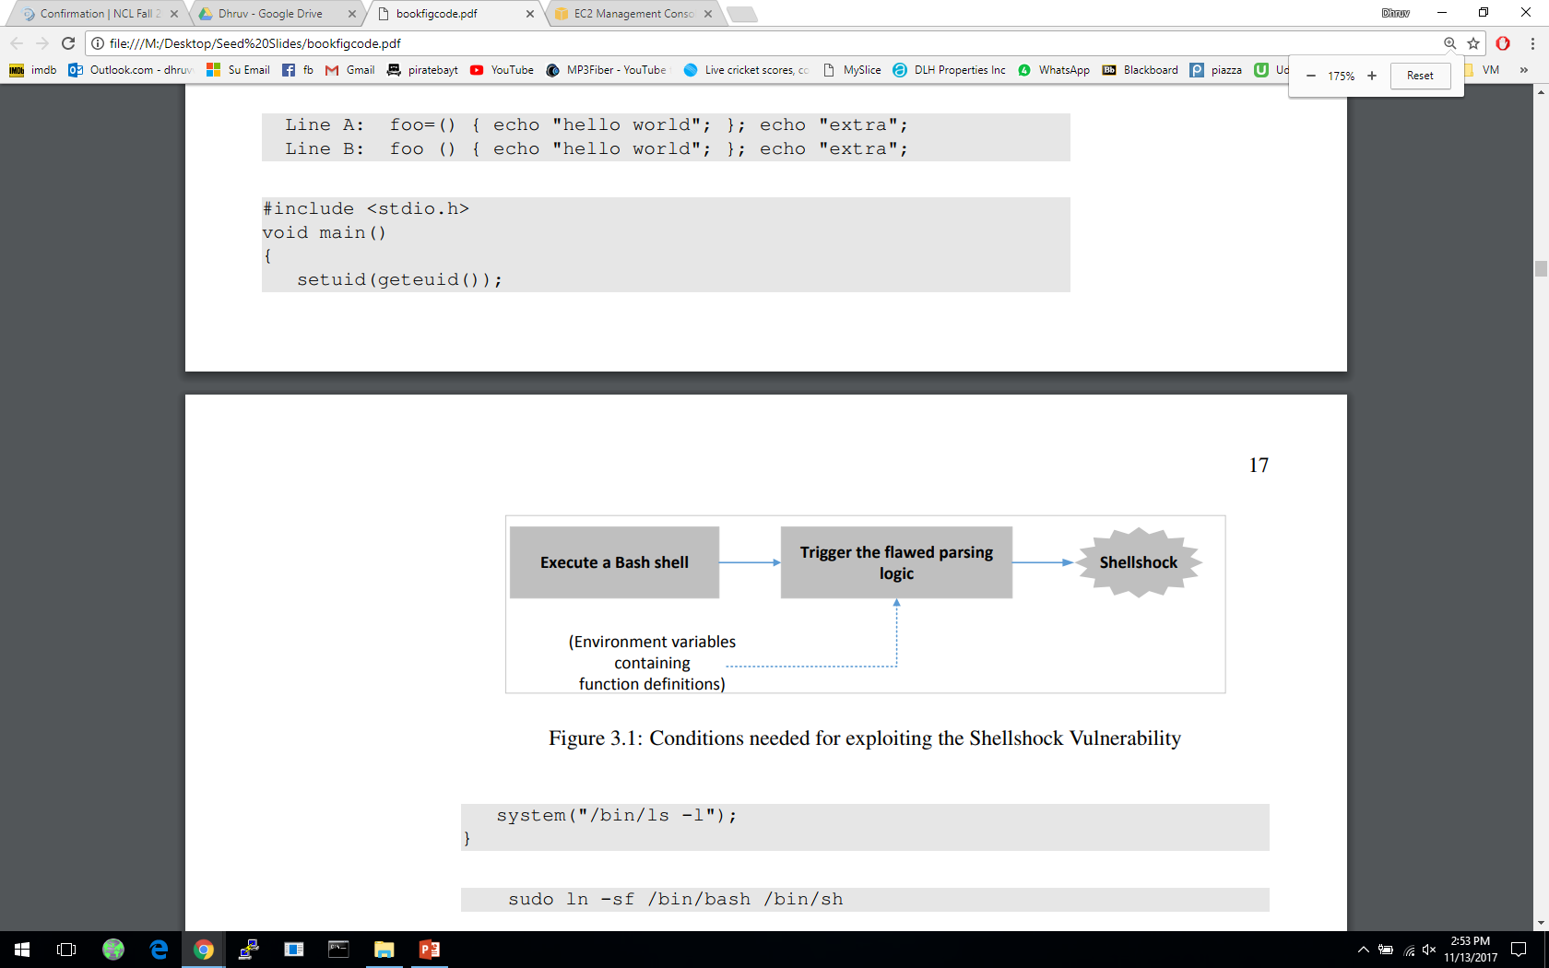
Shellshock Attack on Set-UID Programs
In the following example, a Set-UID root program will start a bash process, when it execute the program /bin/ls via the system() function. The environment set by the attacker will lead to unauthorized commands being executed
Setting up the vulnerable program
Program uses the system() function to run the /bin/ls command
This program is a Set-UID root program
The system function actually uses fork() to create a child process, then uses execl() to execute the /bin/sh program
Notes:
In this section we explore how an attacker can set the environment for a privileged bash process on the local machine, to exploit the shellshock vulnerability and run commands with the target process’s privilege
It should be noted that the above program calls setuid(getuid()) to run the real user ID into the effective user ID. This is not a common practice, but it does happen.
It should also be noted that in our current Ubuntu virtual machine, /bin/sh is a symbolic link to /bin/dash. To demonstrate the attack we need to change the symbolic link to /bin/bash by using :
Sudo ln –sf /bin/bash /bin/sh

Slide 13
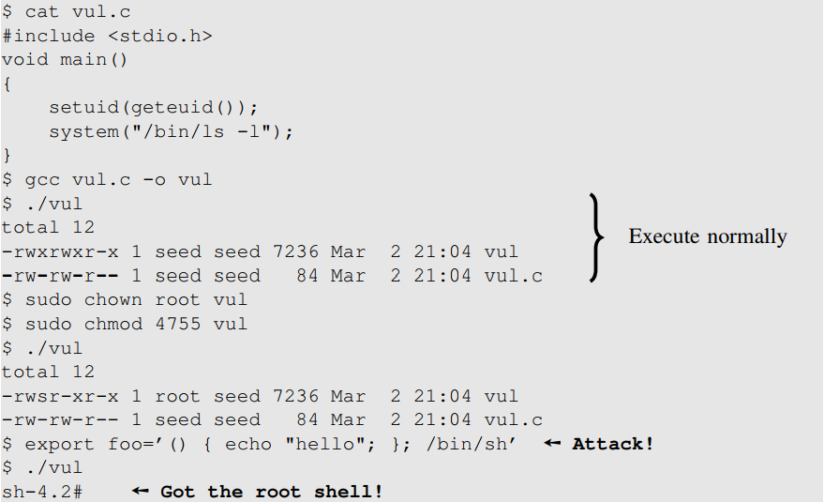
Shellshock Attack on Set-UID Programs
The program is going to invoke the vulnerable bash program. Based on the shellshock vulnerability, we can simply construct a function declaration.
Notes:
Definition of attack:
Our attack basically defiones a shell variable foo
We export this shell variable, so when we run the Set-UID program (vul), the shell variable becomes an environment variable of the child process
Because system() invokes bash, it det4ects that the environment variable is a function declaration
Due to the bug in the parsing logic, it ends up executing the command “/bin/sh”
Hence, we get the root shell

Slide 14
Shellshock Attack on CGI Programs
Common gateway interface (CGI) is utilized by web servers to run executable programs that dynamically generate web pages.
Many CGI programs use shell scripts, if bash is used, they may be subject to the Shellshock attack.

Slide 15
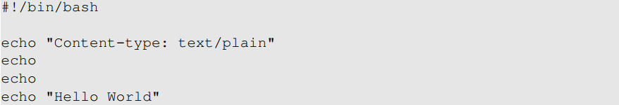
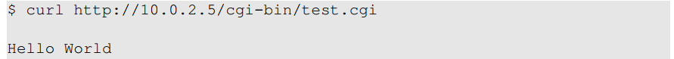
Shellshock Attack on CGI Programs: Setup
We set up two VM’s for this experiment and write a very simple CGI program (test.cgi). One for attacker(10.0.2.6) and one for the victim (10.0.2.5). It is written using bash shell script.
We need to place this CGI program in the victims server’s /usr/bin/cgi-bin directory and make it executable. We can use curl to interact with it.

Slide 16
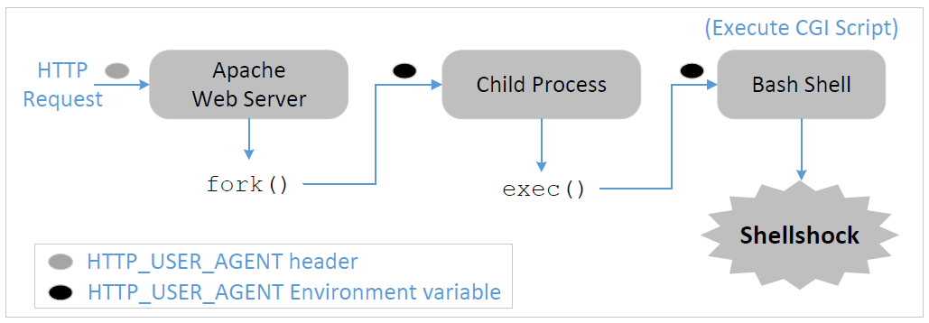
How Web Server Invokes CGI Programs
When a user sends a CGI URL to the Apache web server, Apache will examine the request
If it is a CGI request, Apache will use fork() to start a new process and then use the exec() functions to execute the CGI program
Because our CGI program starts with “#! /bin/bash”, exec() actually executes /bin/bash, which then runs the shell script

Slide 17
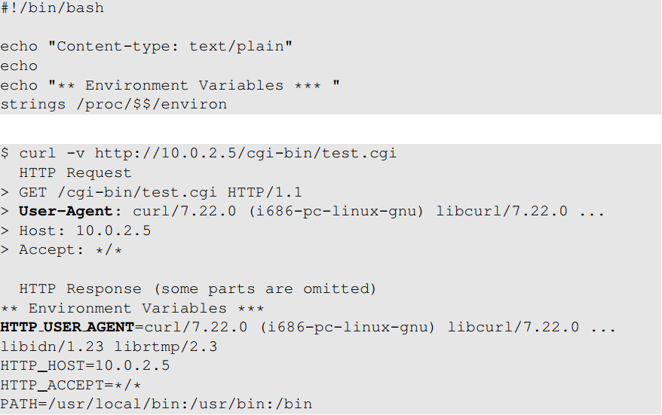
How Use Data Get Into CGI Programs
When Apache creates a child process, it provides all the environment variables for the bash programs.
Using curl to get the http request and response
Pay attention to these two: they are the same: data from the client side gets into the CGI program’s environment variable!
Notes:
We add a line “strings /proc/$$/environ” in the last line to print out all the environment variables of the process
$$ is replaced by bash with the ID of the current process
What is User Agent?
The purpose of this field is to provide some information about the client to he server, to help the server customize its contents for individual client of browser types
What we see here is because we use curl, if we were to use Firefox, the User-Agent field would be different

Slide 18
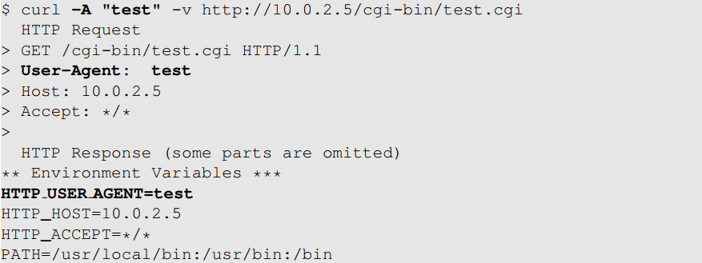
How Use Data Get Into CGI Programs
We can use the “-A” option of the command line tool “curl” to change the user-agent field to whatever we want.
Notes:
Changing the browser to achieve our goal would be too complicated, So we use the command line tool curl

Slide 19
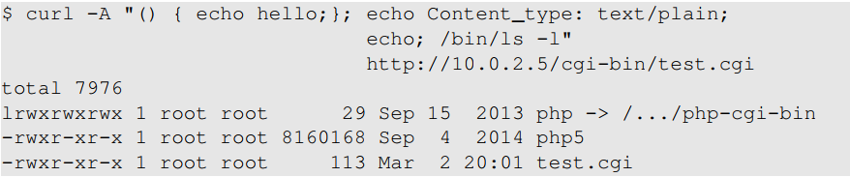
Launching the Shellshock Attack
Our /bin/ls command gets executed.
By default web servers run with the www-data user ID in Ubuntu. Using this privilege , we cannot take over the server, but there a few damaging things we can do.
Notes:
Whatever the CGI program prints will go to the Apache server, which in turn sends the data back to the client
Apache needs to know the type of the content: text, multimedia, or other types

Slide 20
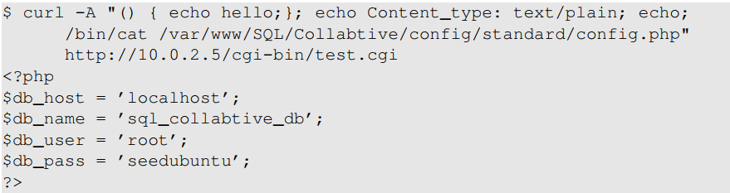
Shellshock Attack: Steal Passwords
When a web application connects to its back-end databases, it needs to provide login passwords. These passwords are usually hard-coded in the program or stored in a configuration file. The web server in our ubuntu VM hosts several web applications, most of which use database.
For example, we can get passwords from the following two files:
/var/www/SQL/collabtive/config/standard/config.php
/var/www/SeedElgg/engine/settings.php
Let’s steal them
Notes:
We can run a command to zip the entire folder on the web server and send it back to us in order to steal files

Slide 21
Shellshock Attack: Create Reverse Shell
Attackers like to run the shell program by exploiting the shellshock vulnerability, as this gives them access to run whichever commands they like
Instead of running /bin/ls, we can run /bin/bash. However, the /bin/bash command is interactive.
If we simply put /bin/bash in our exploit, the bash will be executed at the server side, but we cannot control it. Hence, we need to do something called reverse shell.
The key idea of a reverse shell is to redirect the standard input, output and error devices to a network connection.
This way the shell gets input from the connection and outputs to the connection. Attackers can now run whatever commands they like and get the output on their machine.
Reverse shell is a very common hacking technique used by many attacks.

Slide 22
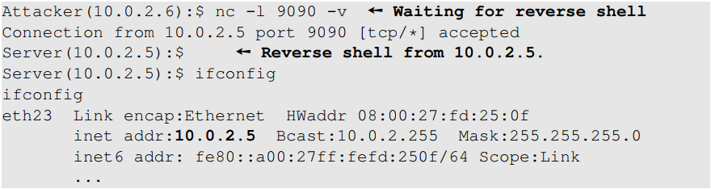
Create a Reverse Shell
We start a netcat (nc) listener on the Attacker machine (10.0.2.6)
We run the exploit on the server machine which contains the reverse shell command ( to be discussed in next slide)
Once the command is executed, we see a connection from the server (10.0.2.5)
We do an “ifconfig” to check this connection
We can now run any command we like on the server machine
Notes:
A commonly used program by attackers is netcat, which if running with the “-l” option, becomes a TCP server that listens for a connection on the specified port
The server program basically prints out whatever is sent by the client, and sends to the client whatever is typed by the user running the server

Slide 23
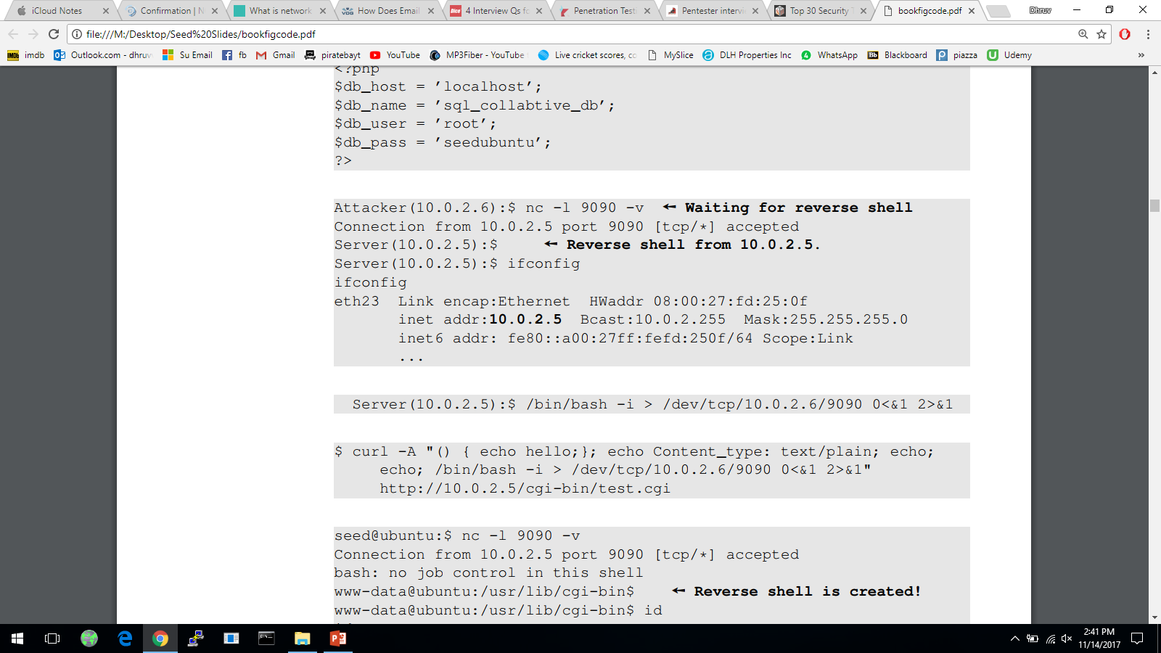
Creating Reverse Shell
The option i stands for interactive, meaning that the shell should be interactive.
This causes the output device (stdout) of the shell to be redirected to the TCP connection to 10.0.2.6’s port 9090.
File descriptor 0 represents the standard input device (stdin) and 1 represents the standard output device (stdout). This command tell the system to use the stdout device as the stdin device. Since the stdout is already redirected to the TCP connection, this option basically indicates that the shell program will get its input from the same TCP connection.
File descriptor 2 represents the standard error (stderr). This cases the error output to be redirected to stdout, which is the TCP connection.
Notes:
In summary, the command starts a bash shell on the server machine whose input comes from a TCP connection and the output goes back to the same TCP connection

Slide 24
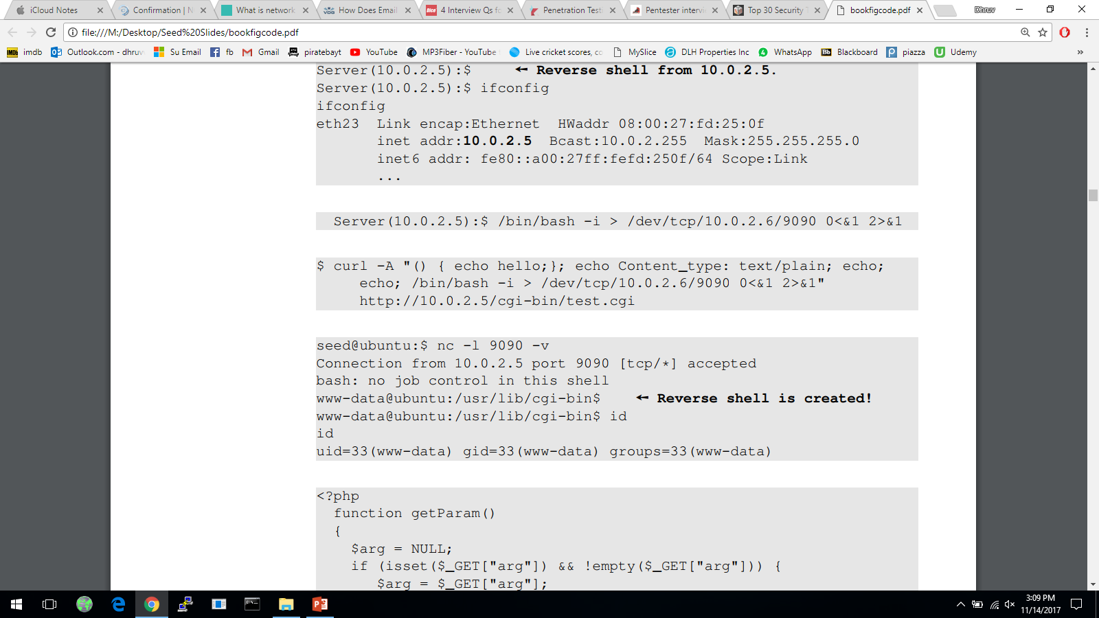
Shellshock Attack on CGI: Get Reverse Shell

Slide 25
Summary
Function definition in Bash
Implementation mistake in the parsing logic
Shellshock vulnerability
How to exploit the vulnerability
How to create a reverse shell using the Shellshock attack

